Slide 1
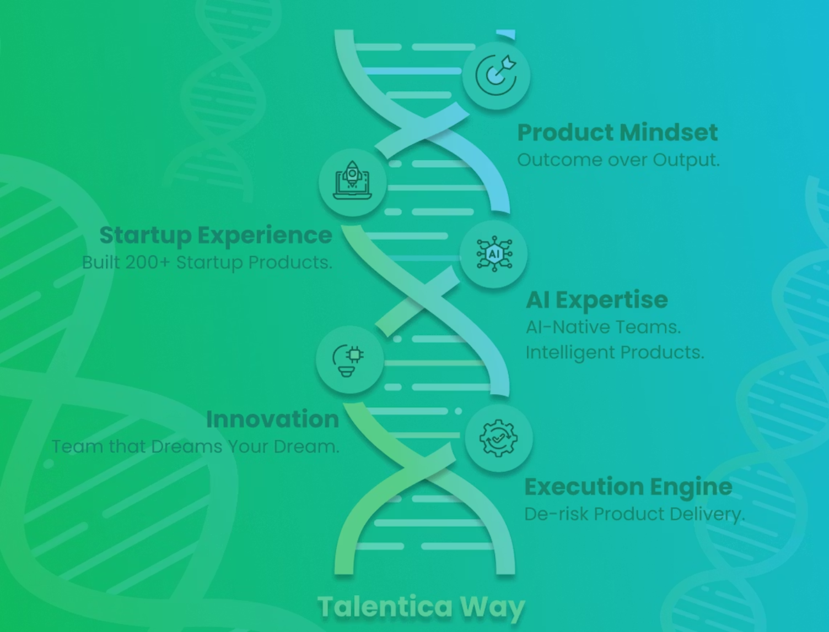
Talentica Software
2003
Founded
In Pune, India
600+
Team Size
AI Native Engineers
200+
Products Built
Across US, Europe, India

Slide 2



SAFEIN5 - PROPOSAL
Our
Understanding
SafeIn5 Platform
Big Picture, Personas & User flows
TALENTICA SOFTWARE

Slide 3
SFAEIN5 - PROPOSAL
Our
Understanding
The Big Picture
SafeIn5 helps frontline workers / technicians make safer decisions by turning everyday observations into shared safety awareness before incidents occur.
The product is built around the PULSE and SIGNAL behavioural systems
PULSE
Pause, Uncover, Learn, Shift, Echo — a frontline behavioural loop that helps workers identify risks early, make safer decisions, and share learnings before work proceeds.
SIGNAL
Sense, Identify, Gather, Navigate, Alert, Loop — a shared safety intelligence loop that captures frontline observations, surfaces patterns and risks, and feeds learning back into future safety decisions.
TALENTICA SOFTWARE

Slide 4



SAFEIN5 - PROPOSAL
MVP PURPOSE
Framework validation
Validate that frontline workers can quickly capture and share safety observations in real operational environments & Reinforce ”safer by sharing”
PULSE
Capture first, structure later interactions at the point of work in less than 60 Seconds
QR Driven contextual Safety Workflows
Low friction frontline participation with repeat usage
SIGNAL
Receive signals from the front line through community sharing, QR journeys.
Identify Risk pattern and Anomalies
Feed intelligence to the frontline
Route insights to the right people
Mobile First
Usability in Industrial environments
Workers should be able to operate with Gloves and goggles – minimum typing, easy to use.
TALENTICA SOFTWARE

Slide 5



SAFEIN5 - PROPOSAL
USER PERSONAS
Primary users of the Mobile application
The following 3 personas benefit the most from the application.
Frontline Worker / Technician
Supervisor / Site lead
SafeIn5 Platform
Administrator
Key contributor to PULSE – Identify and share risks without disrupting the work
Improve situational awareness and increase proactive reporting.
Responsible for setting up the tenants, users, configurations and workflows
TALENTICA SOFTWARE

Slide 6
SAFEIN5 - PROPOSAL
USER SCENARIO
(Corporate)
Rigging and Fixtures User Scenario
Context
Dave and his crew are preparing a heavy fixture lift using a custom spreader beam and chain assembly
The team is under schedule pressure because the crane window is limited.
At the lifting area entrance, there is a QR code attached to the lifting zone barrier.
The QR is linked to
Lift-specific PULSE (Take 5)
Rescue / emergency procedure
Learn 5 content for suspended loads and pinch points
USER PERSONA
Name – Dave Smith
Role – Senior Rigger and Fixture Installation Technician
ENVIRONMENT
Heavy Fabrication Yard
Has intermittent WiFi or Cellular Connectivity
DEVICE
Personal Mobile Phone or Company issued rugged device
Workers with Gloves and Goggles.
TALENTICA SOFTWARE

Slide 7
SAFEIN5 - PROPOSAL
STEP BY
STEP
USER
JOURNEY
  QR Scan before starting work
1
The app opens the SafeIn5 PULSE Screen based on the Site location, Task type, Asset etc.
PULSE (Take 5)
2
Guides the user through the process with instructions – Pause – look around, what looks different, Shackle orientation is unusual. Tag line placement can create a problem
Learn – Learn 5 Card appears – Incorrect shackle loading can create side loading failures.
Shift – Repositions the tag line
Echo - Share this with others.
Rescue Plan Review
3
Rescue plan provides task –specific emergency response
procedures, roles, contacts and required equipment
4
Signal Capture
Click the share button to take a picture, provide description - Potential side loading problem on shackle
Classification and Confirmation
5
Dave helps classify this as something to be aware of and confirms the signal. Can share anonymously
6
Feed Visibility
The photo along with the context and the classification appears in the feed that is shared with all workers on the site.
Superior Awareness
7
3 Similar Be Awares in 2 weeks related to lifting fixtures. Supervisor can then reinforce safety to the team the next morning.
TALENTICA SOFTWARE

Slide 8
SAFEIN5 - PROPOSAL
STEP BY
STEP
USER
JOURNEY
(Community flow)
  Observe hazard
1
Member notices an open manhole
Quick Capture
Takes a photograph and adds a text note or a voice note. Alternatively records a video. Geo Location is automatically attached if permissions allow
2
Community Feed
3
Classifies as something to be aware of and
needs immediate attention and shares to the
community feed
4
Moderation and Verification
Shared content is reviewed and duplicates removed
Authority / Owner notification
5
Signal is escalated to concerned authorities
wherever applicable
6
Resolution and feedback
Status updates shared back with the community
TALENTICA SOFTWARE

Slide 9
SAFEIN5 - PROPOSAL
USABILITY
Sharing without disrupting work
SafeIn5 fits naturally into the workers daily routine
QR Code scan and check lift plans
Check before doing
No Long forms
No multiple clicks
Zero mandatory fields
Photo first
Context auto attached
Voice memos with minimal typing – all under 60 seconds
Share anonymously
Captures near miss situations early
Quick trends to help supervisors take action
Work in low connectivity environments
TALENTICA SOFTWARE

Slide 10

SAFEIN5 - PROPOSAL
MVP SCOPE
Key Features, In-Scope, Out of Scope, NFR’s
TALENTICA SOFTWARE

Slide 11
SAFEIN5 - PROPOSAL
Key MVP features
MVP GOALS
Mobile First PWA app
User Engagement
A cloud native, multi-tenant, SaaS platform
that is front line friendly
Instrument and track usage metrics for improving feature adoption and engagement
Performance
Context Aware QR workflows
Frictionless capture in <60s.
Low network connectivity resilience
Context linked to QR codes – site, subsite, asset, Learn 5. rescue plan etc.
Future Signal Readiness
Designed for “Safer by Sharing”
Reactive Reporting to shared behavioral awareness in the future
Influencer model rather than compliance driven.
TALENTICA SOFTWARE

Slide 12
SAFEIN5 - PROPOSAL
SCOPE
MVP Scope
The following Features will be included as a part of MVP (Ref. SafeIn5 Dev Pack V9 Issue.pdf).
All items that are marked MUST and SHOULD have been included in the scope.
Mobile App
User authentication and role based access
QR contextual routing
PULSE flow – optional attributes to be attached wherever allowed
Behaviour Signal capture – photo, video, text, voice
Media upload
Classification – 3 options
Learn 5 – content management and mapping
Feed Visibility
Supervisor flow
Lightweight Admin module
Learn 5 content management
Organisation / site / subsite setup
User Management
Site, Fixtures and other asset setup
QR Context mapping to site, subsite, assets, learn 5 content, Rescue plan etc.
Search
Basic dashboard – Engagement Analytics
Feed Moderation
TALENTICA SOFTWARE

Slide 13
SAFEIN5 - PROPOSAL
OUT OF
SCOPE
MVP - Not in Scope
Phase 2 scope
The following are planned for Phase 2 and are not part of the MVP
AI / ML / predictive models and automated classification.
Multilingual / localisation (the MVP is English-only).
Full offline-first capture and sync store.
SSO / enterprise IdP integration.
SaaS billing / subscriptions / super-admin panel (the MVP keeps the architecture ready for this).
Cross-site / industry benchmarking, risk heat map, master-library CRUD, advanced/deep search, and predictive nudges.
Automated insights workflow (auto-generated push notifications).
Manual / user tagging in the feed.
Full theming / design-system customisation (beyond tenant logo and colour).
Features Not Required
The following are explicitly out of scope and not planned
Legacy data migration.
Corporate / external system integrations.
Native iOS / Android apps
Bulk user import / CSV provisioning (Community self-registration is in scope)
Physical QR sticker production and hardware.
Automatic face-blurring
TALENTICA SOFTWARE

Slide 14
SAFEIN5 - PROPOSAL
NFRs
Non-Functional requirements
The proposed architecture supports the following Non-functional requirements
Area | Definition
Users | ~60 users across pilot sites, with architecture designed for scale to additional sites and organisations.
Learn 5 Content | ~20–30 learning modules authored by SafeIn5 and uploaded into the system for contextual delivery.
Video Capture | Maximum video duration of 30 seconds per clip to control payload size and ensure fast uploads.
Supported Browsers | Safari (iOS) and Chrome (Android) for field and mobile usage.
Data Residency & Privacy | EU-based data residency with GDPR compliance, including export, delete, and retention policies. Anonymity enforced at database layer, tenant-based isolation between Community and Corporate data. Append-only audit logging enabled.
Deployment Model | Multi-tenant deployment supporting 3 organisations × 3 sites plus a shared Community tenant, initially focused on UK extractive/quarrying domain.
TALENTICA SOFTWARE

Slide 15

SAFEIN5 - PROPOSAL
TECHNICAL
SOLUTION
Principles, Architecture, Design,
Tech Stack
TALENTICA SOFTWARE

Slide 16
SAFEIN5 - PROPOSAL
Technical Approach and Principles
TECHNICAL
SOLUTION
MVP Philosophy
Scalable foundation – Not a throwaway MVP
Future Ready architecture and Design for scale.
Build – Measure - Learn
Instrument the platform to capture usage metrics to
drive product decisions
Outcome driven MVP scope management
Balance between cost, time to market and product.
Prioritize scope based on success metrics
Fail Fast
Validate assumptions before investing
UX principles
Context specific content
Show Learn5, Rescue Plan etc. specific to the context
(site, subsite, asset) to avoid scroll, click etc.
Media not forms – Designed for Harsh environments
Photos, Videos, Voice notes to minimize keyboard usage
for usability with Gloves and goggles.
Capture First, Sync Later
Allows users to complete workflows with Async uploads
and retries built-in
Themes for Corporate branding / personalization
Architecture
Cloud Native, Multi-tenant architecture
Data segregation at tenant level.
REST Services for scale and modularity
Adapter pattern for Integrations such as Learn 5
Content integration
API first design
Configurable workflows for AI readiness
Relationship aware data model to enable better insights
Future Readiness
Workflows designed such that they can be replaced by
AI Agents in the future
Separate Intelligence Layer to replace Rule based insights
by ML Models for future SIGNAL intelligence
QR Ecosystem expansion – QR routing implemented as
a configurable workflow to support future expansion
Corporate and Community Operating models supported
by Tenants and Configurable workflows
TALENTICA SOFTWARE

Slide 17
SAFEIN5 - PROPOSAL
ARCHITECTURE
System Architecture
The proposed SafeIn5 system architecture is divided into 5 layers to support the Mobile first PULSE experience and scalable SIGNAL loop and Insights. Intelligence Layer supports the future AI needs.
Layer | Components | Responsibilities
Experience Layer | Mobile PWA (Community, Worker, Supervisor)Desktop Admin Console | Mobile-first experience for Community and Corporate users, supporting QR Scan, PULSE, Behaviour Signal Capture, Feed, Search, Learn 5, Rescue Plans and Supervisor Actions. Desktop-first administration experience supporting organisation setup, user management, QR configuration, content management, moderation and analytics.
Security & Access Layer | API Gateway, Authentication, Authorization, Identity Management, Roles, Tenancy, Audit Logging | Secure API access to platform services through authentication, role-based access control, tenant isolation, and audit logging to ensure data protection and governance.
Core Platform Services Layer | Behavioural Signal Service, Media Service, Classification Service, Search Service, QR Service, Workflow Service, Notification Service, Context Engine | REST services implementing core SafeIn5 capabilities including signal capture and lifecycle management, media processing, classification, search, QR context mapping, workflow execution and notifications.
Data & Media Layer | Operational Database, Media Storage, Audit Store | Stores behavioural signals, PULSE sessions, workflows, users, sites, assets, QR mappings, learning content, rescue plans, audit logs, photos, and videos with tenant isolation and row-level security.
Intelligence Layer | Event Outbox, Event Streams, Metrics Collection | Captures structured behavioural events, workflow events, context relationships, and usage metrics enabling future analytics, intelligence, and predictive insights.
TALENTICA SOFTWARE

Slide 18
SAFEIN5 - PROPOSAL
SOLUTION
DESIGN
Design Principles
The following principles guide the design decisions to ensure alignment to SafeIn5 current and future requirements
Requirement | How We Achieve It
Under 60-Second Capture | Single-screen capture experience, one-tap classification, background media uploads, and No mandatory inputs.
Voice & Media First Experience | Speech to Text, photo and video-first capture, minimal keyboard usage, large touch targets, and glove/goggle-friendly interactions.
Low Connectivity Resilience | Capture-first-sync-later, queued uploads, automatic retries
Anonymity | Anonymity is enforced at the data layer for MVP purposes and masked in audit logs. True anonymity will require masking of location, non-reversal by the admins etc. which is not considered as a part of MVP.
Context-Aware | QR-driven contextual routing, automatic attachment of site/sub-site/asset/task context, contextual PULSE and Rescue Plans
Corporate & Community models | Configurable workflows, multi-tenant architecture, role-based experiences
Flexible Learning Platform Integration | Adapter pattern to enable external integrations
Usage Metrics | Collect metrics such as active users, PULSE completion rates, SIGNAL Captures per user, Feed interactions, QR Scan frequency, and Anonymous usage to gain insights on Adoption.
TALENTICA SOFTWARE

Slide 19
SAFEIN5 - PROPOSAL
Application Tech Stack
Data and Platform
TECH STACK
Language & runtime | Node.js (LTS) + TypeScript
Backend framework | NestJS on the Fastify adapter
Database access | Kysely (typed query builder) over Postgres
Validation | Zod
Field app (Worker & Supervisor) | Next.js 14 (App Router) + React 18, installable PWA
Admin Console | Next.js / React destop web app — not a PWA
UI | Tailwind CSS + Radix primitives
Client state & forms | TanStack React Query + React Hook Form
Media processing | sharp (thumbnails), qrcode (QR generation)
Authentication | Custom magic-link + email OTP + JWT; bcrypt for admin passwords
Notifications | web-push (VAPID)
Logging & metrics | Pino (structured logs); Prometheus-format metrics
Testing | Jest + Supertest + Testcontainers (API); Playwright + Testing-Library (web)
Usage Metrics – Telemetry Capture | Microsoft Clarity, MixPanel
Primary database | Managed Postgres 16
Search | Postgres full-text search
Object / media store | S3-compatible (S3 / GCS)
Domain events | Transactional outbox in Postgres + polling worker
Background work | In-process workers — outbox flusher, rule-based alert evaluator, transcription dispatch
Packaging & hosting | Docker container on a managed PaaS (App Runner / Cloud Run / Container Apps)
Environments | Dev / Staging / Production
Backup | Managed database backups
Third Party Services
Cloud AWS or GCP | Compute, managed Postgres, object store, CDN/WAF, secrets, container registry, log sink
Email-sending service (e.g. SES / SendGrid) | Magic-link, OTP, email verification, password reset
Speech-to-text provider | Voice-first capture transcription
Web push (VAPID) | Notifications
Sentry | Client-side error tracking
GitHub Actions | CI/CD pipeline
TALENTICA SOFTWARE

Slide 20
SAFEIN5 - PROPOSAL
DELIVERY
Approach, Milestones, Timelines
Assumptions, Risks and Touchpoints
TALENTICA SOFTWARE

Slide 21
SAFEIN5 - PROPOSAL
Approach
DELIVERY
A phased delivery approach focused on early validation, incremental development to de-risk the project
Discovery and Scope Sign off
MVP Development
Validate user journeys, finalize UX Design,
Signoff on MVP Scope based on budget,
priorities and timeline
Build and deploy in staging the end-end SafeIn5 MVP for Community and Corporate users
UAT and Signoff
Post MVP support
MVP Validation by SafeIn5,
Feedback resolution and formal acceptance.
A support team to be setup on T&M basis post the MVP delivery
TALENTICA SOFTWARE

Slide 22
SAFEIN5 - PROPOSAL
DELIVERY
Milestones & Deliverables
MVP development is organized into parallel work streams – PWA and Admin, with milestones structured to deliver end-end features that can be validated by users, not just demonstrated.
Milestone | Key Activities
Milestone 1 – Discovery & UX Design | Stakeholder workshops, user journey validation, UX design, architecture discussion, MVP scope prioritization and finalization
Milestone 2 – Foundation & PULSE MVP | Admin & Platform: Tenant setup, user management, authentication, authorization, site/sub-site configuration, basic content uploaded to test the PULSE flow. PWA: PWA shell, branding/theme framework, PULSE flow, signal capture – Image, voice notes, media upload and save and share
Milestone 3 – Context, Learning & Workflow Foundation | Admin & Platform: Learn 5 management, QR management, context configuration, feed management, signal workflow foundation. PWA: QR-driven contextual journeys, contextual PULSE experiences, Learn 5 consumption, feed experience, search
Milestone 4 – Supervisor, Analytics & Platform Completion | Admin & Platform: Supervisor workflows, approvals, notifications, analytics dashboards, moderation, reporting, GDPR compliance, deployment readiness. PWA: Anonymous reporting, community feed, notifications, worker feedback loop, remaining user experience enhancements.
Milestone 5 – UAT & Sign-off | End-to-end user acceptance testing, defect resolution and handover documentation.
TALENTICA SOFTWARE

Slide 23
SAFEIN5 - PROPOSAL
DELIVERY
Delivery timelines
Milestone | Deliverables | Timeline | Talentica Responsibility | SafeIn5 Responsibility
Milestone 1 – Discovery & UX Design | Agreed user journeys, detailed UX design, validated technical approach, and a prioritized MVP scope baseline. Maximum 2 concepts to be provided and arrive at one detailed design | 2 Weeks | Provide 2 concepts and one detailed end –end design | UX and MVP Scope Signoff
Milestone 2 – Foundation & PULSE MVP | End-to-end PULSE and signal capture journey operational, allowing users to sign in, complete a PULSE flow, capture a behavioural signal, and submit it. | 4 weeks | Features deployed on Staging | Test data availability and Feature signoff
Milestone 3 – Context, Learning & Workflow Foundation | Context-aware worker experience operational with QR routing, learning content, contextual feeds, and workflow integration. | 3 weeks | Features deployed on Staging | Test data availability and Feature signoff
Milestone 4 – Supervisor, Analytics & Platform Completion | Complete MVP delivered for workers, supervisors, and administrators with workflows, analytics, notifications, governance, and reporting capabilities on staging | 3 weeks | Features deployed on Staging | Feature signoff
Milestone 5 – UAT & Sign-off | Business-validated MVP formally accepted and ready for production deployment. | 2 weeks | Feedback incorporation and production rollout | MVP signoff
TALENTICA SOFTWARE

Slide 24
SAFEIN5 - PROPOSAL
DELIVERY
SLA’s
Recommended SLA’s
We propose the following SLA’s for timely delivery of the SafeIn5 MVP platform
Milestone Governance
Milestone Signoff – 3-5 business days from submission
Final MVP Signoff – 1-2 weeks from submission
UAT Closure – 2 weeks
Scope freeze after discovery – 1 week
UX Design
Concept Validation turn around time – <3 days
UX Design – 3-5 days
Change Resolution
Acknowledgement – 1-2 business days
Impact Analysis – 2-3 business days
Approval - < 3days
Environment availability
Staging availability – 95%
Release to staging frequency – End of each milestone
Production roll out – Milestone 5
TALENTICA SOFTWARE

Slide 25
SAFEIN5 - PROPOSAL
DELIVERY
Assumptions
The following assumptions have been made
SafeIn5 will provide Talentica with the cloud account for the dev, staging and production environments
Test Data for MVP validation to be provided by SafeIn5
The cost and timelines proposed are limited to the MVP ( Phase 1) scope defined in SafeIn5 Dev Pack V9 Issue.pdf.
Any scope change will follow the formal change request process where in the change is logged, impact analyzed ( cost, timeline and effort) and approved by SafeIn5 before implementation.
SafeIn5 will provide timely access to decision makers, decisions and test data within SLA’s
All estimates assume usage of AI tools such as cursor and claude code. The cost of tool is included in the estimates.
Risks
UX design and MVP Scope Signoff within 3 weeks
SafeIn5 Team availability for user testing and signoff on features
TALENTICA SOFTWARE

Slide 26
SAFEIN5 - PROPOSAL
COMMERCIALS
MVP Cost, Milestone wise cost breakup, Payment schedule
TALENTICA SOFTWARE

Slide 27
SAFEIN5 - PROPOSAL
COMMERCIALS
Commercials and Payment terms
The project will be executed on a Fixed Price basis.
The estimated cost of the MVP development is GBP 45,000, based on the current high-level scope definition. This will be refined and finalized upon completion of the Discovery phase. Variations from the estimate are expected to be within 15–20%, depending on final scope clarity.
Milestone | % Payment
Discovery & UX Design | 15%
Foundation & PULSE MVP | 20%
Context, Learning & Workflow Foundation | 25%
Supervisor, Analytics & Platform Completion | 25%
UAT & Sign-off | 15%
Post MVP Support - A support team to be setup on T&M basis post the MVP delivery for minor enhancements
TALENTICA SOFTWARE

Slide 28
SAFEIN5 - PROPOSAL
Why Talentica?
Built and scaled 200+ products across domains
Supply Chain & Trust
Autodesk - Construction
Compliance
Field workers
Provenance Chain Network, Agritech Traceability POC
We have developed iOS/Android app to for usage in the field (construction sites). Primarily to create and update issues, reference project documents
Credila Audit Module, Fintech AML Compliance
Developed a PWA for agriculture field workers. Requirement was to provide ability to upload images, videos regarding crops, growth, daily progress etc.
Designed blockchain-based provenance architecture; integrated complex supplier hierarchies
Built audit-friendly systems with versioning, trace logs, and regulatory export formats
TALENTICA SOFTWARE

